Slide 1
Network Layer:
Logical Addressing

Slide 2
3-1 IPv4 ADDRESSES
An IPv4 address is a 32-bit address that uniquely and universally defines the connection of a device (for example, a computer or a router) to the Internet.
Topics discussed in this section:
Address Space Notations
Classful Addressing
Classless Addressing
Network Address Translation (NAT)

Slide 3

Note
An IPv4 address is 32 bits long.
The IPv4 addresses are unique and universal (all nodes connecting Internet must have IP addresses).
The address space of IPv4 is 2³² or 4,294,967,296.

Slide 4
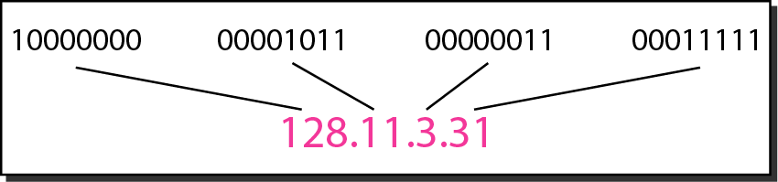
Figure 3.1 Dotted-decimal notation and binary notation for an IPv4 address

Slide 5
Note
Numbering systems are reviewed in Appendix B.

Slide 6
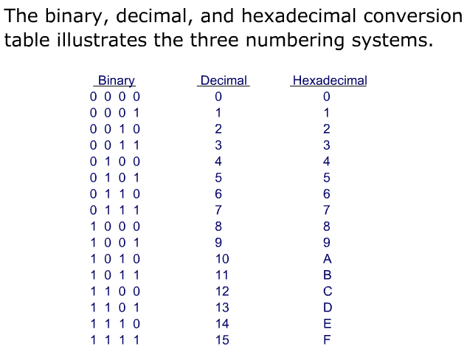
Obtained from http://www.wisc-online.com

Slide 7
Example 3.1
Change the following IPv4 addresses from binary notation to dotted-decimal notation.
Solution
We replace each group of 8 bits with its equivalent decimal number (see Appendix B) and add dots for separation.

Slide 8
Example 3.2
Change the following IPv4 addresses from dotted-decimal notation to binary notation.
Solution
We replace each decimal number with its binary equivalent (see Appendix B).

Slide 9
Example 3.3
Find the error, if any, in the following IPv4 addresses.
Solution
a. There must be no leading zero (045).
b. There can be no more than four numbers.
c. Each number needs to be less than or equal to 255.
d. A mixture of binary notation and dotted-decimal notation is not allowed.

Slide 10
Note
In classful addressing, the address space is divided into five classes:
A, B, C, D, and E.

Slide 11
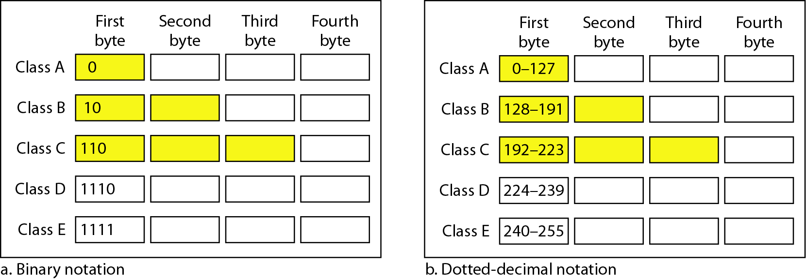
Figure 3.2 Finding the classes in binary and dotted-decimal notation
Class D: multicast
Class E: reserved

Slide 12
Example 3.4
Find the class of each address.
a. 00000001 00001011 00001011 11101111
b. 11000001 10000011 00011011 11111111
c. 14.23.120.8
d. 252.5.15.111
Solution
a. The first bit is 0. This is a class A address.
b. The first 2 bits are 1; the third bit is 0. This is a class C address.
c. The first byte is 14; the class is A.
d. The first byte is 252; the class is E.

Slide 13
Table 3.1 Number of blocks and block size in classful IPv4 addressing

Slide 14
Note
In classful addressing, a large part of the available addresses were wasted.

Slide 15
Note
Classful addressing, which is almost obsolete, is replaced with classless addressing.

Slide 16
Note
In IPv4 addressing, a block of addresses can be defined as
x.y.z.t /n
in which x.y.z.t defines one of the addresses and the /n defines the mask.
Usually, x.y.z.t is the first address in the address block

Slide 17
Note
The first address in the block can be found by setting the rightmost 32 − n bits to 0s.

Slide 18
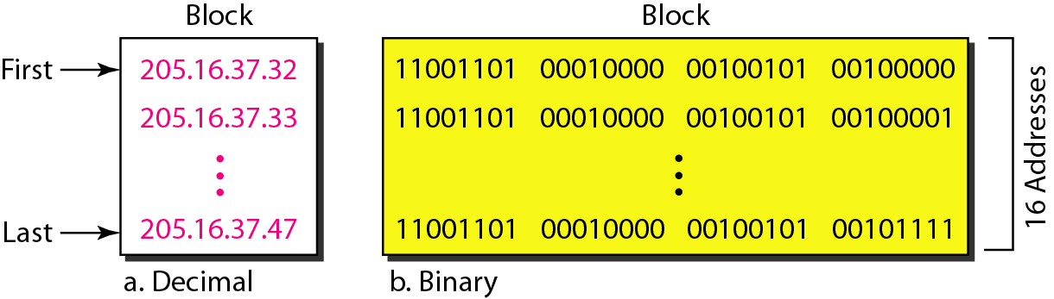
Figure 3.3 A block of 16 addresses granted to a small organization
We can see that the restrictions are applied to this block. The addresses are contiguous. The number of addresses is a power of 2 (16 = 2⁴). This block of IP addresses is represented by:
205.16.37.32/28

Slide 19
Example 3.6
A /28 block of addresses is granted to a small organization. We know that one of the addresses is 205.16.37.39. What is the first address in the block? What is its x.y.z.t/n representation?
Solution
The binary representation of the given address is
11001101 00010000 00100101 00100111
If we set 32−28 rightmost bits to 0, we get
11001101 00010000 00100101 0010000 0
or 205.16.37.32
The block representation is 205.16.37.32/28

Slide 20
Note
The last address in the block can be found by setting the rightmost 32 − n bits to 1s.

Slide 21
Example 3.7
Find the last address for the block in Example 3.6.
Solution
The binary representation of the given address is
11001101 00010000 00100101 00100111
If we set 32 − 28 rightmost bits to 1, we get
11001101 00010000 00100101 00101111
or
205.16.37.47
This is actually the block shown in Figure 3.3.

Slide 22
Note
The number of addresses in the block can be found by using the formula 2^{32−n}.

Slide 23
Example 3.9
Another way to find the first address, the last address, and the number of addresses is to represent the mask as a 32-bit binary (or 8-digit hexadecimal) number. This is particularly useful when we are writing a program to find these pieces of information. In Example 3.5 the /28 can be represented as
11111111 11111111 11111111 11110000
(twenty-eight 1s and four 0s).
Find
a. The first address
b. The last address

Slide 24
Example 3.9 (continued)
Solution
a. The first address can be found by ANDing the given addresses with the mask. ANDing here is done bit by bit. The result of ANDing 2 bits is 1 if both bits are 1s; the result is 0 otherwise.

Slide 25
Example 3.9 (continued)
b. The last address can be found by ORing the given addresses with the complement of the mask. ORing here is done bit by bit. The result of ORing 2 bits is 0 if both bits are 0s; the result is 1 otherwise. The complement of a number is found by changing each 1 to 0 and each 0 to 1.

Slide 26
Figure 3.4 A network configuration for the block 205.16.37.32/28

Slide 27
Note
The first address in a block is normally not assigned to any device; it is used as the network address that represents the organization to the rest of the world.

Slide 28
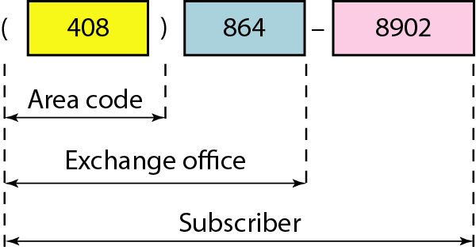
Figure 3.5 hierarchy in telephone numbers

Slide 29
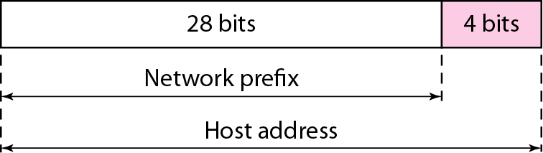
Figure 3.6 hierarchy in IP addressing

Slide 30
Note
Each address in the block can be considered as a two-level hierarchical structure: the leftmost n bits (prefix) define the network;
the rightmost 32 − n bits define the host.

Slide 31
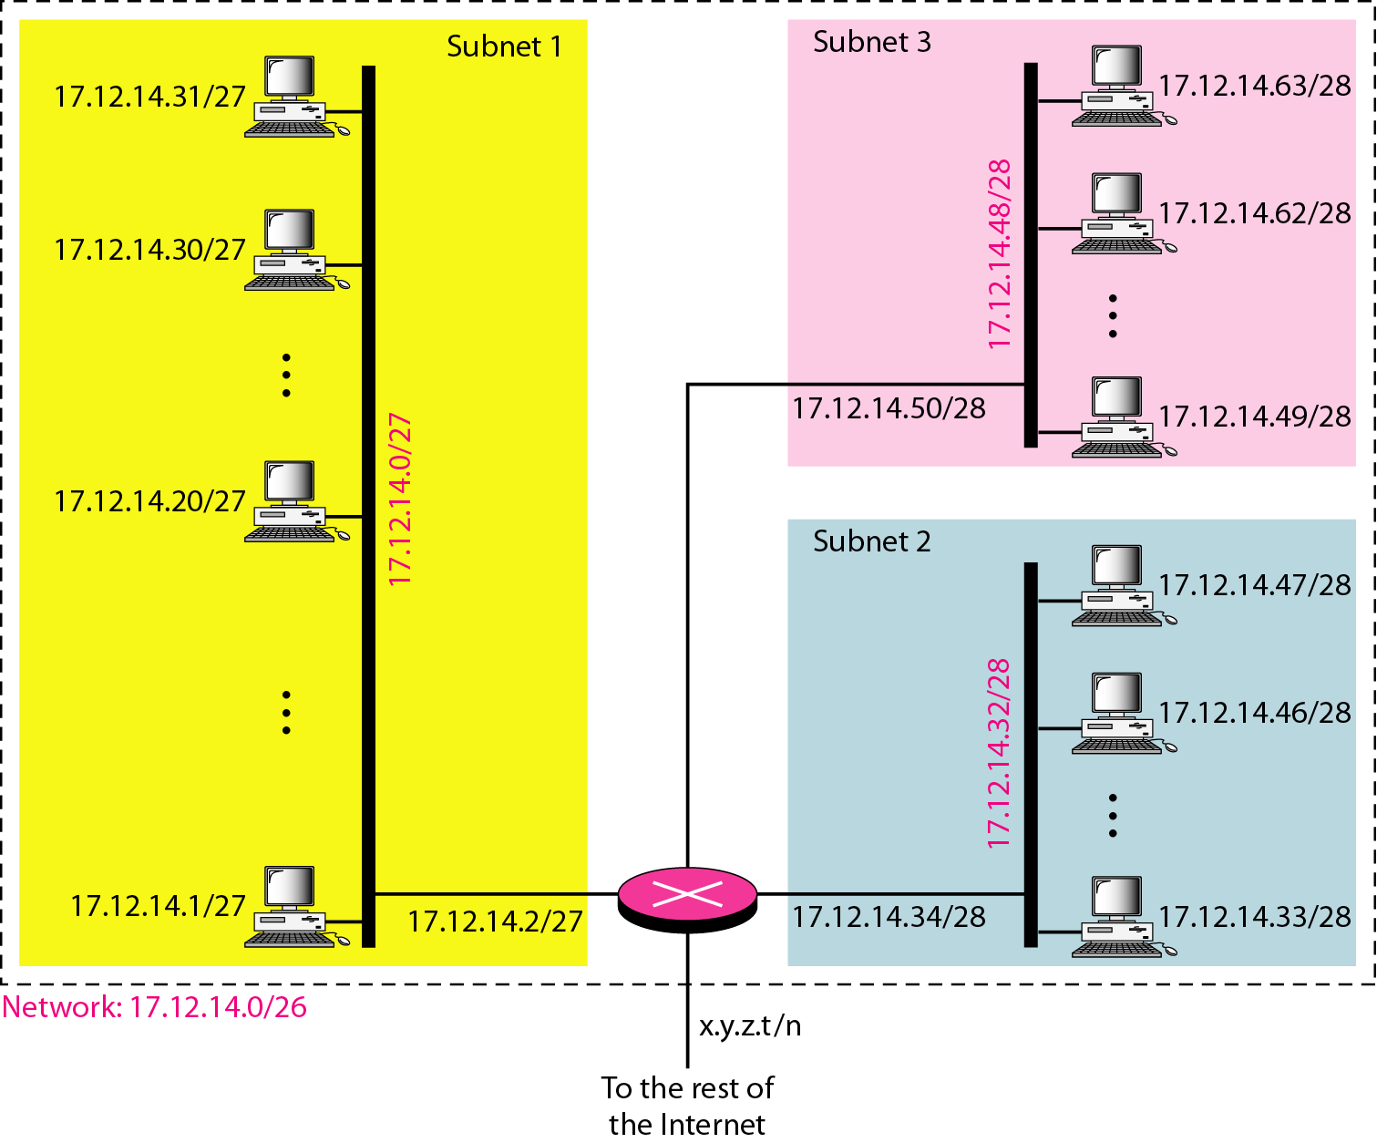
Figure 3.7 Configuration and addresses in a subnetted network

Slide 32
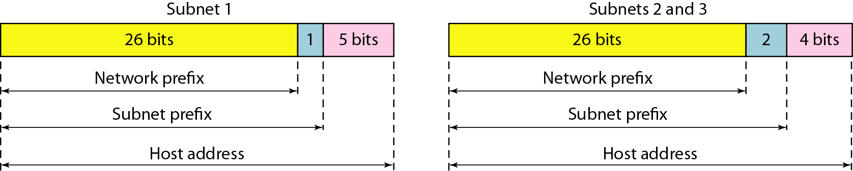
Figure 3.8 Three-level hierarchy in an IPv4 address

Slide 33
Example 3.10
An ISP is granted a block of addresses starting with 190.100.0.0/16 (65,536 addresses). The ISP needs to distribute these addresses to three groups of customers as follows:
a. The first group has 64 customers; each needs 256 addresses.
b. The second group has 128 customers; each needs 128 addresses.
c. The third group has 128 customers; each needs 64 addresses.
Assume the blocks of IPs are sequentially assigned. Design the subblocks and find out how many addresses are still available after these allocations.

Slide 34
Example 3.10 (continued)
Solution
Figure 3.9 shows the situation.
Group 1
For this group, each customer needs 256 addresses. This means that 8 (log2 256) bits are needed to define each host. The prefix length is then 32 − 8 = 24. The addresses are

Slide 35
Example 3.10 (continued)
Group 2
For this group, each customer needs 128 addresses. This means that 7 (log2 128) bits are needed to define each host. The prefix length is then 32 − 7 = 25. The addresses are

Slide 36
Example 3.10 (continued)
Group 3
For this group, each customer needs 64 addresses. This means that 6 (log₂64) bits are needed to each host. The prefix length is then 32 − 6 = 26. The addresses are
Number of granted addresses to the ISP: 65,536
Number of allocated addresses by the ISP: 40,960
Number of available addresses: 24,576

Slide 37
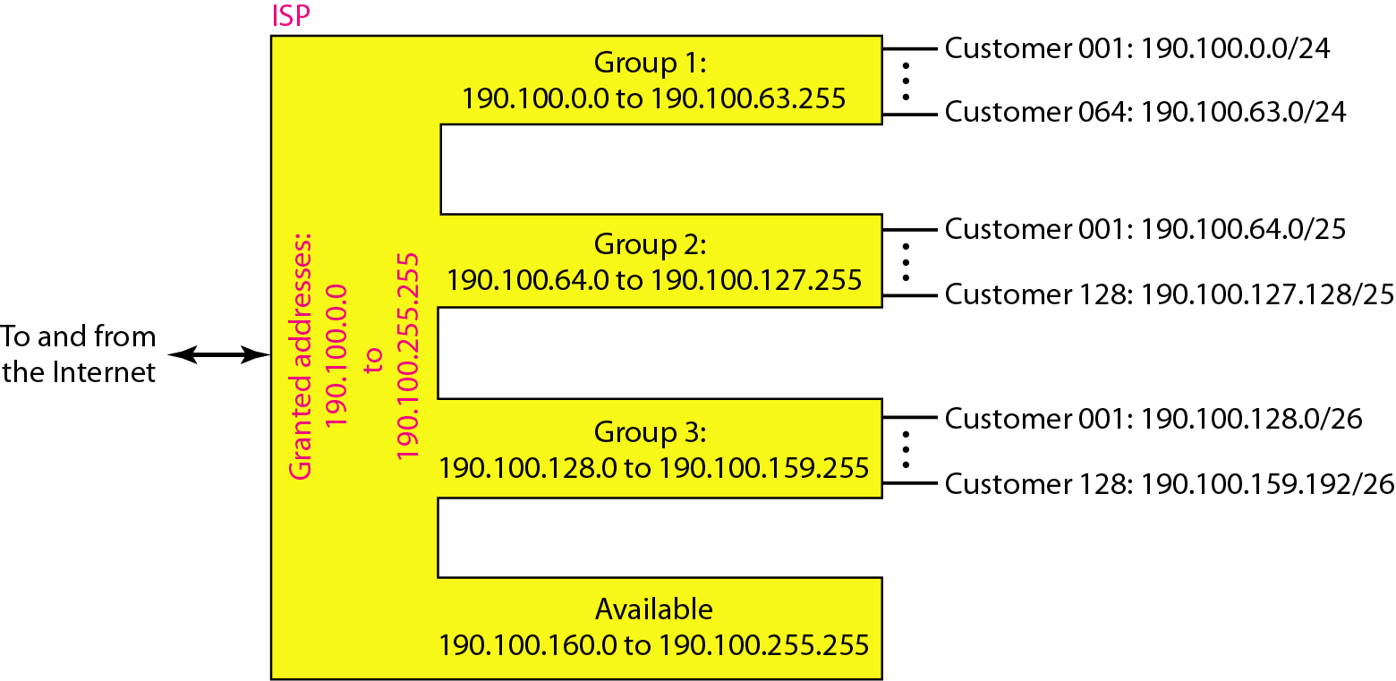
Figure 3.9 An example of address allocation and distribution by an ISP

Slide 38
Another Example on Subnetting
An ISP needs to allocate three subnets: Subnet 1, Subnet 2, and Subnet 3 with its acquired IP block of 223.1.17.0/24. Subnet 1 is required to support 63 interfaces, Subnet 2 is to support at least 40 interfaces, and Subnet 3 is to support at least 95 interfaces. In addition, values of IP addresses have the relationship: Subnet 1 < Subnet 2 < Subnet 3.
Provide three network addresses ( of the form a.b.c.d/x) that satisfy these constraints.

Slide 39
Subnetting
223.1.17.0/24, ip addresses are 2^(32-24) = 256
Subnet 1 needs 2^6=64, 223.1.17.0/26
last address: 223.1.17.63
Subnet 2 needs 2^6=64, 223.1.17.64/26
last address: 223.1.17.127
Subnet 3 needs 2^7 = 128, 223.1.17.128/25

Slide 40
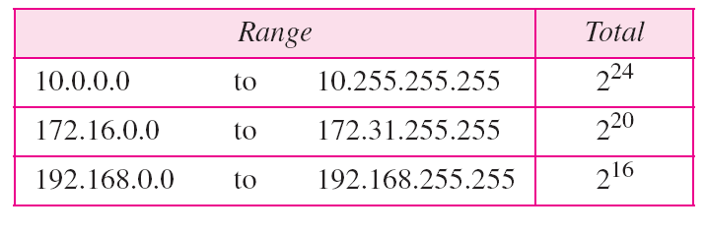
Table 3.3 Addresses for private networks
Home used wireless router usually uses 192.168.1.0/24
or 192.168.0.0/24 IP block

Slide 41
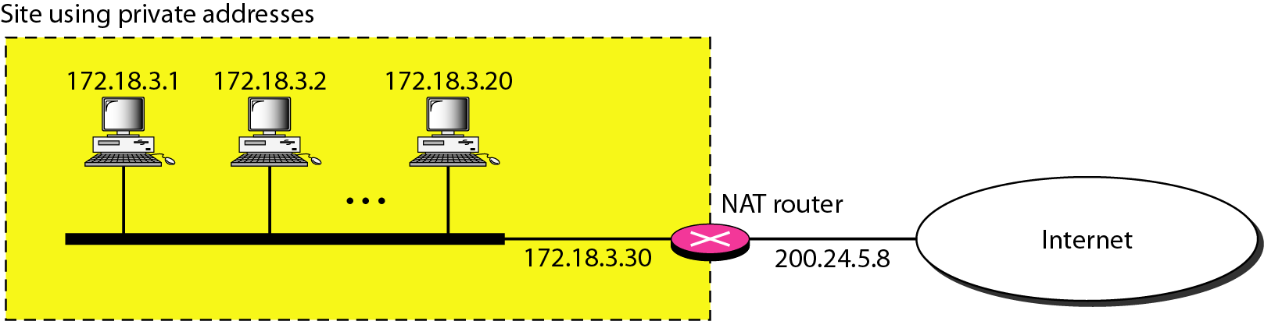
Figure 3.10 A NAT implementation

Slide 42
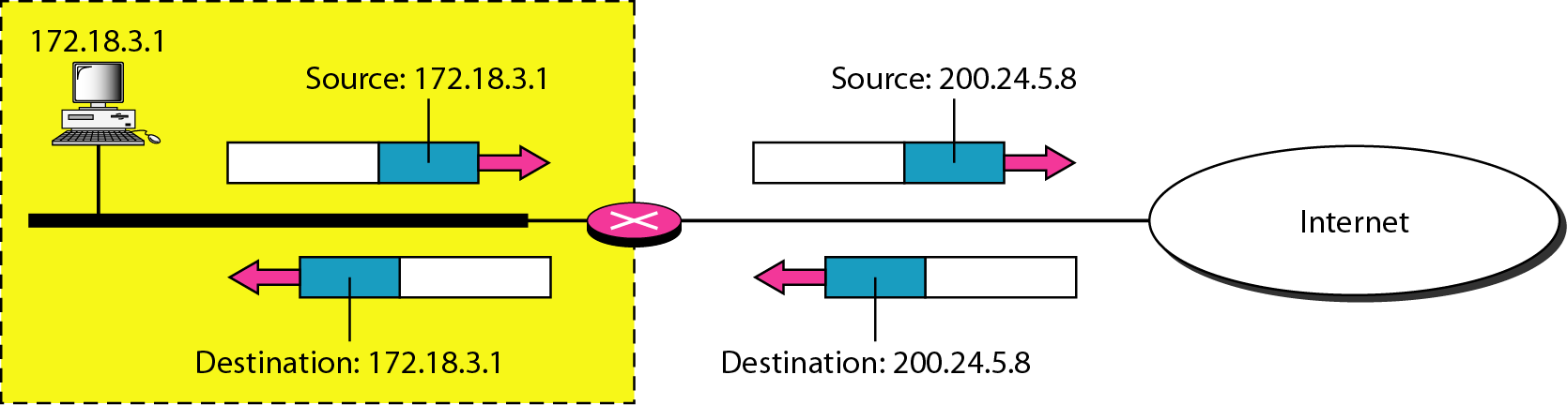
Figure 3.11 Addresses in a NAT

Slide 43
NAT: Network Address Translation
NAT translation table
WAN side addr LAN side addr
1: host 10.0.0.1
sends datagram to
128.119.40.186, 80
2: NAT router
changes datagram
source addr from
10.0.0.1, 3345 to
138.76.29.7, 5001,
updates table
138.76.29.7, 5001 10.0.0.1, 3345
…… ……
S: 10.0.0.1, 3345
D: 128.119.40.186, 80
10.0.0.1
1
2
S: 138.76.29.7, 5001
D: 128.119.40.186, 80
10.0.0.4
10.0.0.2
138.76.29.7
S: 128.119.40.186, 80
D: 10.0.0.1, 3345
4
S: 128.119.40.186, 80
D: 138.76.29.7, 5001
3
4: NAT router
changes datagram
dest addr from
138.76.29.7, 5001 to 10.0.0.1, 3345
10.0.0.3
3: Reply arrives
dest. address:
138.76.29.7, 5001

Slide 44
NAT: Network Address Translation
16-bit port-number field:
60,000 simultaneous connections with a single LAN-side address!
NAT is controversial:
violates end-to-end argument
Internal computers not visible to outside
Outside hosts have trouble to request service from local computers, e.g., P2P, video conference, web hosting.
address shortage should instead be solved by IPv6

Slide 45
Table 3.4 Five-column translation table

Slide 46
3-2 IPv6 ADDRESSES
Despite all short-term solutions, address depletion is still a long-term problem for the Internet. This and other problems in the IP protocol itself have been the motivation for IPv6.
Note
An IPv6 address is 128 bits long.

